Slide 1

Hackathon Pro Kabaddi League

Slide 2
Objective
To gather the data about Pro Kabaddi League from different sources by the means of copying and / or scrapping and predict the following:
Winner of Pro Kabaddi League, Season 7
Top team in the points table
Top team with highest successful raids
Top team with highest successful tackles
Top team with highest super performance total
Player with highest successful raid percentage
Player with highest successful tackle percentage

Slide 3
Approach
Data Gathering
Data Understanding
Modelling
Scrap the respective sites for data gathering
Create Dataframe
Data Analysis
Derived variables
Lasso Regression
Validating Model
Chosen apt alpha.
Prediction on Test Dataset
Validating predictions against the present statistics of Season 7
Data cleansing
Use Json feed from PKL official site
Gather data in CSV, import CSV
Different model for each task
Model trained on previous seasons and tested in Season 7 data
Plot the graph
Lasso score on test and train data
Mean squared error

Slide 4
Data cleansing
Variables are derived wherever required from the current variables.\
Dropped some of the unwanted variables which would not be influencing the model like:
Venue
Month
Year etc.

Slide 5
Python & Data files for each model
Task | Python File name | Data File
Data Extraction | Team Data Extraction.ipynb | Used JSON feed from official website to extract the data team_data.xlsx for information on teams team_stats.xlsx for different statistics
Predict the top team in the points table after the completion of league matches | Task 2 - Predict_Top_Team.ipynb | team_data_model.xlsx
Predict the team with the highest points for successful raids | Task 3 - Highest_Sucessful_Raids.ipynb | team_detail.xlsx
Predict the team with the highest points for successful tackles | Task 4 - Highest_Sucessful_Tackles.ipynb | team_data_model.xlsx
Predict the team with the highest super-performance total | Task 5 - Super_Performance.ipynb | final_team_master_data.xlsx team_stats.xlsx
Predict the player with the highest SUCCESSFUL RAID percentage | Task 6 - Highest-Sucessful Raids % - Player.ipynb | player_details.xlsx match_cleaned.xlsx

Slide 6
Python & Data files for each model
Task | Python File name | Data File
Predict the player with the highest SUCCESSFUL TACKLE percentage | Task 7 Highest-Sucessful Tackles % - Player.ipynb | player_cleaned_data.xlsx
Predict the winner of the tournament | Task 1 - Winner_of_the_tournament.ipynb | team_detail.xlsx

Slide 7
Algorithm used
After much deliberation and trying different algorithms, we chose Lasso regression for our modelling, for the following reasons:
It takes care of regularization of the data without compromising on the confidence of the model output
It act as hyper parameter by making the least or not required coefficients to zero
It provides a stable and robust model as compared to other algorithms
It is quick to implement as compared to other algorithms
Our r2 score is nearly 90s for both Train and Test data

Slide 8
Result evaluation
We used the previous seasons’ data (Season 1 to Season 6) to train the model and Season 7 data to test our model.
The data has been fed into the model on daily basis to see if there is any change from the previous statistics.
The prediction provided by the model is then compared against the statistics available on Pro Kabaddi League official website
The predictions, by far, matched the present statistics of the PKL.

Slide 9
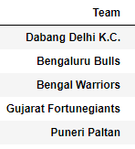
Predictions – Top Team
Basis our model in “Task 2 - Predict_Top_Team.ipynb”, Dabang Delhi seems to be the top team in the points table in league stage.
We have taken successful & unsuccessful raids & tackles along with winning team and toss winner into consideration

Slide 10
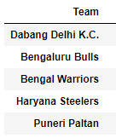
Predictions – Highest Successful Raid
Basis our model in “Task 3 - Highest_Sucessful_Raids.ipynb”, Dabang Delhi seems to have highest successful raids.

Slide 11
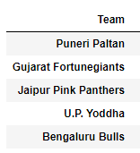
Predictions – Highest Successful Tackles
Basis our model in “Task 4 - Highest_Sucessful_Tackles.ipynb”, Puneri Palthan seems to have highest successful tackles.

Slide 12
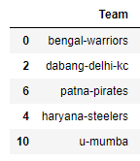
Predictions – Super Performance
Basis our model in “Task 5 - Super_Performance.ipynb”, Bengal Warriors seems to be performing much better than others

Slide 13
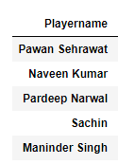
Predictions – Highest Successful Raid %age
Basis our model in “Task 6 - Highest-Sucessful Raids % - Player.ipynb”, Pawan Sehrawat will be the most accomplishing Raider.

Slide 14
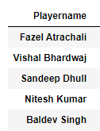
Predictions – Highest Successful Tackle %age
Basis our model in “Task 7 - Highest-Sucessful Tackles % - Player.ipynb”, Faizal will out do other defenders.

Slide 15
Predictions – Tournament Winner
Basis our model in “Task 1 - Winner_of_the_tournament.ipynb”, Bengaluru Bulls have high chances of winning the tournament.

Slide 16

Thank You!

